Slide 1
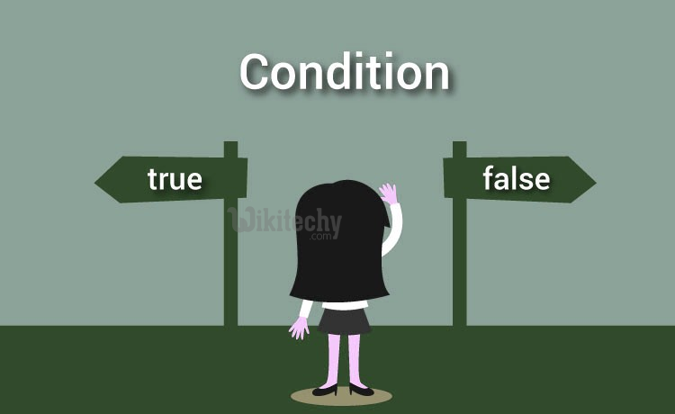
Conditionals
Boolean values and operators, conditional (if), alternative (if-else), chained conditional (if-elif-else); Iteration: state, while, for, break, continue, pass

Slide 2
Boolean
Boolean data type have two values. They are 0 and 1.
0 represents False
1 represents True
True and False are keyword.

Slide 3
Boolean
Example:
3==5 False
6==6 True
True+True
2
False+True
1
False*True
0
Other Examples …….

Slide 4
Operators and Types
OPERATORS: (Discussed in Unit-2)
Operators are the constructs which can manipulate the value of operands.
Consider the expression 4 + 5 = 9. Here, 4 and 5 are called operands and + is called operator.
Types of Operators:
Arithmetic Operators
Comparison (Relational) Operators
Assignment Operators
Logical Operators
Bitwise Operators
Membership Operators
Identity Operators

Slide 5
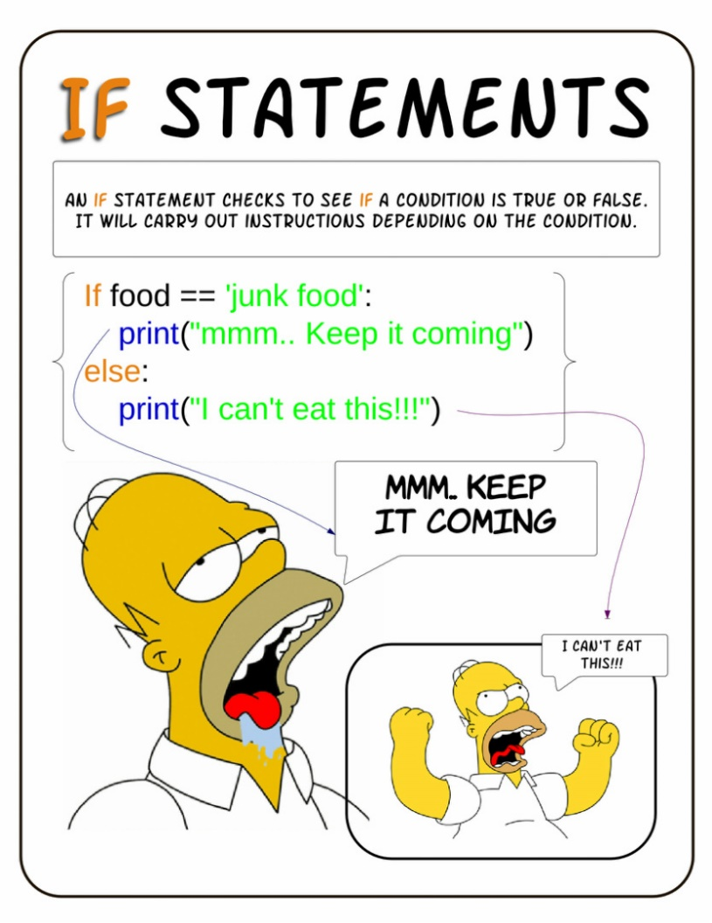
Conditionals
Conditional if
Alternative if… else
Chained if…elif…else
Nested if….else

Slide 6
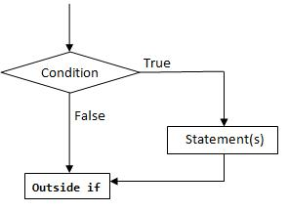
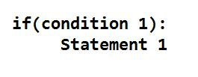
Conditional if
conditional (if) is used to test a condition, if the condition is true the statements
inside if will be executed.
syntax:

Slide 7
Conditional if
Examples ….
Program to provide flat rs 500, if the purchase amount is greater than 2000.
Program to provide bonus mark if the category is sports.

Slide 8
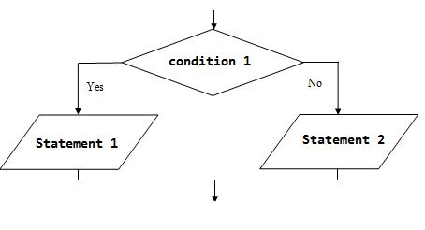
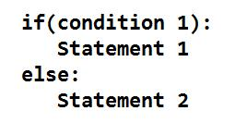
If - Else
In the alternative the condition must be true or false. In this else statement can be combined with if statement. The else statement contains the block of code that executes when the condition is false. If the condition is true statements inside the if get executed otherwise else part gets executed. The alternatives are called branches, because they are branches in the flow of execution.
syntax:

Slide 9
If - Else
Examples …….
odd or even number
positive or negative number
Eligibility for Voting
Greatest or Smallest Number
,…….
…….

Slide 10
Chained Conditionals
The elif is short for else if.
This is used to check more than one condition.
If the condition1 is False, it checks the condition2 of the elif block. If all the conditions are False, then the else part is executed.
Among the several if...elif...else part, only one part is executed according to the condition.
The if block can have only one else block. But it can have multiple elif blocks.
The way to express a computation like that is a chained conditional

Slide 11
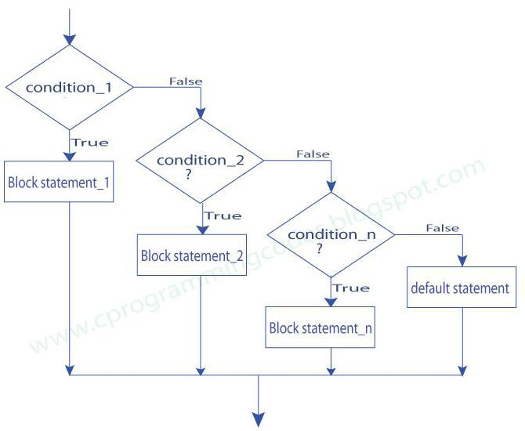
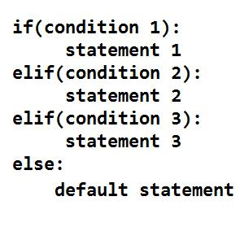
Chained Conditionals
syntax:

Slide 12
Chained Conditionals
Examples ……
student mark system
traffic light system
compare two numbers
roots of quadratic equation

Slide 13
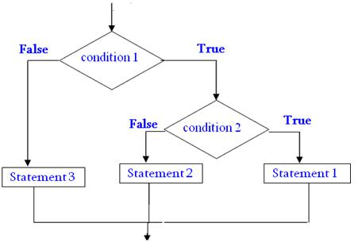
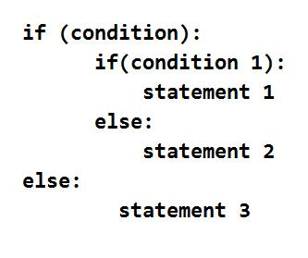
Nested Conditionals
One conditional can also be nested within another. Any number of condition can be nested inside one another. In this, if the condition is true it checks another if condition1. If both the conditions are true statement1 get executed otherwise statement2 get execute. if the condition is false statement3 gets executed.
Syntax:

Slide 14
Nested Conditionals
Examples ….
1. greatest of three numbers
2. positive negative or zero

Slide 15
Iterations and Control Statements
State ?
While
For
Break
Continue
Pass

Slide 16
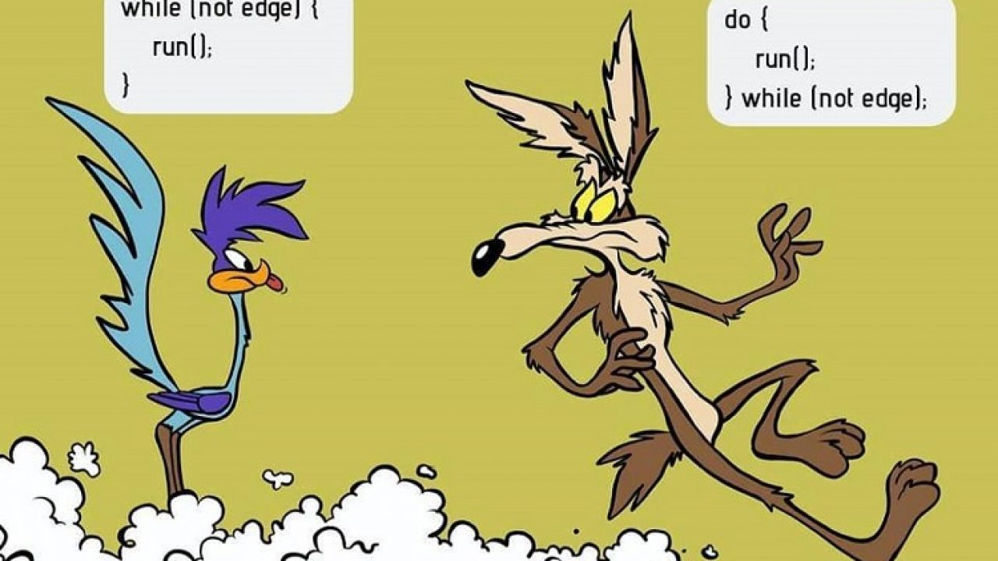
State
Transition from one process to another process under specified condition with in a time is called state.

Slide 17

While
While loop statement in Python is used to repeatedly executes set of statement as long as a given condition is true.
In while loop, test expression is checked first. The body of the loop is entered only if the test_expression is True. After one iteration, the test expression is checked again. This process continues until the test_expression evaluates to False.
In Python, the body of the while loop is determined through indentation.
The statements inside the while starts with indentation and the first unindented line marks the end.

Slide 18
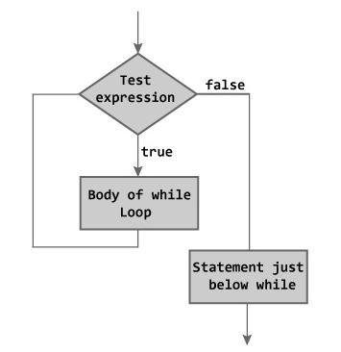
While

Slide 19
While
Examples …….
program to find sum of n numbers:
program to find factorial of a number
program to find sum of digits of a number:
Program to Reverse the given number:
Program to find number is Armstrong number or not
Program to check the number is palindrome or not

Slide 20
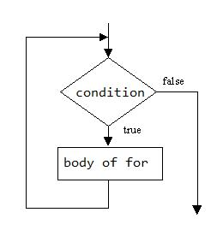
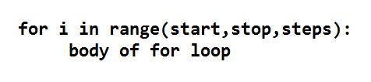
For
for in range:
We can generate a sequence of numbers using range() function. range(10) will generate numbers from 0 to 9 (10 numbers).
In range function have to define the start, stop and step size
as range(start,stop,step size). step size defaults to 1 if not provided.

Slide 21

For
For in sequence
The for loop in Python is used to iterate over a sequence (list, tuple, string). Iterating over a sequence is called traversal. Loop continues until we reach the last element in the sequence.
The body of for loop is separated from the rest of the code using indentation.

Slide 22
For
Examples ……
print nos divisible by 5 not by 10:
Program to print fibonacci series.
Program to find factors of a given number
check the given number is perfect number or not
check the no is prime or not
Print first n prime numbers
Program to print prime numbers in range

Slide 23
Loop Control Structures
Break
Continue
Pass

Slide 24
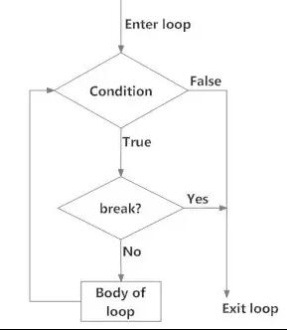
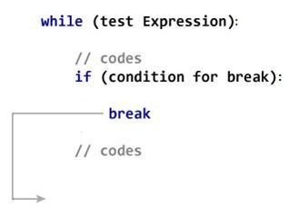
Break
Break statements can alter the flow of a loop.
It terminates the current loop and executes the remaining statement outside the loop.
If the loop has else statement, that will also gets terminated and come out of the loop completely.
Syntax: break

Slide 25
Break
Examples ………

Slide 26
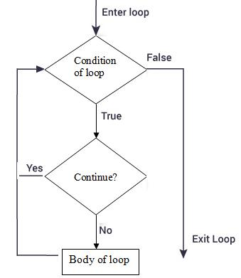
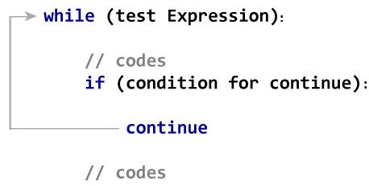
Continue
It terminates the current iteration and transfer the control to the next iteration in the loop.
Syntax: continue

Slide 27
Continue
Examples ……

Slide 28
Pass
It is used when a statement is required syntactically but you don’t want any code to execute.
It is a null statement, nothing happens when it is executed.
Syntax: pass
Examples ……

Slide 29
Difference: Break and Continue
break |  |  |  |  |  | continue
It terminates the current loop and |  |  |  |  |  | It terminates the current iteration and
executes the remaining statement outside |  |  |  |  |  | transfer the control to the next iteration in
the loop. |  |  |  |  |  | the loop.
syntax: |  |  |  |  |  | syntax:
break |  |  |  |  |  | continue
for i in "welcome": |  |  |  |  |  | for i in "welcome":
if(i=="c"): |  |  |  |  |  | if(i=="c"):
break |  |  |  |  |  | continue
print(i) |  |  |  |  |  | print(i)
w |  |  |  |  |  | w
e |  |  |  |  |  | e
l |  |  |  |  |  | l
 |  |  |  |  |  | o
 |  |  |  |  |  | m
 |  |  |  |  |  | e

